Slide 1
Kerberos
Application Layer Authentication Service

Slide 2
Securing Internet Traffic
Application-level security
  Secure the traffic between two communicating applications
  Application-specific protocols
  Example: SSL/TLS for web traffic
IP-level security
  Secure traffic at the Internet Protocol layer (low-level wire format)
  Applications don’t have to know about security specifically, they “get it for free”
  Example: IPSEC
January 24, 2006
Practical Aspects of Modern Cryptography

Slide 3
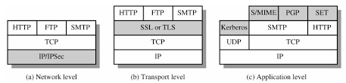

Slide 4

Kerberos
A practical authentication service
Kerberos: three headed dog in Greek mythology, the guardian of the entrance of Hades
Those three heads in security: AAA (Authentication, Accounting, Audit)
However in Kerberos the last two heads never implemented

Slide 5
KERBEROS
Users wish to access services on servers.
Three threats exist:
  User pretend to be another user.
  User alter the network address of a workstation.
  User eavesdrop on exchanges and use a replay attack.
Henric Johnson

Slide 6
Authentication as a Service
we have seen several authentication protocols
now we will see a system where we can use such a protocol in practice

Slide 7
Kerberos
an “authentication service” based on symmetric key crypto
developed at MIT
alternative to implementing an authentication protocol with each application server
  instead a centralized authentication server manages authentication between users and application servers/workstations
provides centralized third-party authentication in a distributed network
  allows users access to services through distributed network without needing to trust all workstations
  rather everybody trusts a central authentication server
two versions in use: 4 and 5

Slide 8
Kerberos Requirements
security
  opponents should not be able to gain access
reliability (availability)
  a Kerberos server or its substitute should be available all the time
scalability
  system should be able to support large amount of users
reliability and scalability imply a distributed architecture
transparency
  users should see the system as a username/password system

Slide 9
Kerberos Protocols
implemented using an authentication protocol based on Needham-Schroeder
  not exactly the same
we will explain them by starting some simple protocols

Slide 10
A Simple Authentication Dialogue
Authentication Server (AS)
  knows the passwords of all clients
  shares secret key with each server (K_{server})
  also provides access control by checking if a client is authorized to access a particular server
Client → AS: ID_{client} || Pass_{Client} || ID_{Server}
AS → Client: Ticket
Client → Server: ID_{client} || Ticket
Ticket = E (K_{server}, [ID_{client} || Addr_{client} || ID_{server}])
Questions
  why ID_{client} is sent also unencrypted in 3?
  why do we need Addr_{client} in ticket?
Notes:
ID_client is needed to check if the ticket submitter is the client or not. It is analogous to ordinary tickets that bear a name on it. The server should check your identity before accepting that ticket.
Client’s network address is included in the ticket in order to prevent an attacker to capture the ticket and to submit as if it is the legit client.

Slide 11
A Simple Authentication Dialogue
Remaining problems
  password is sent in clear
  ticket replay prevention
  proof of authentication (ID and address check) is not so strong
  ticket reuse
    very important for a practical system
Why ticket reuse is necessary?
  avoid entering password several times (say in a day)
    would you like to enter your password everytime IMAP client checks your inbox?
    would you like to enter the same password for each service (like print service, file server, …)?

Slide 12
Improved Authentication Dialogue
a new server called Ticket Granting Server (TGS) is employed
  AS is still there, but does not issue tickets for servers. AS issues tickets for TGS
    ticket-granting ticket
  TGS issues tickets for servers
    service-granting ticket
Password transfer is avoided by encrypting AS messages to clients using a key derived from password
still not complete

Slide 13











Slide 14












Slide 15
Improved Authentication Dialogue - 1
messages 1 and 2 are per logon session
  Client → AS: ID_{Client} || ID_{TGS}
  AS → Client: E (K_{client}, [Ticket_{TGS}])
Ticket_{TGS} = E (K_{TGS}, [ID_{Client} || Addr_{Client} || ID_{TGS} || Timestamp₁ || Lifetime₁])

Slide 16
Improved Authentication Dialogue - 2
messages 3 and 4 are per server
  Client → TGS: ID_{Client} || ID_{Server} || Ticket_{TGS}
  TGS → Client: Ticket_{Server}
message 5 is per service session
  Client → Server: ID_{Client} || Ticket_{Server}
Ticket_{Server} = E (K_{server}, [ID_{Client} || Addr_{Client} || ID_{Server} || Timestamp₂ || Lifetime₂])

Slide 17
Improved Authentication Dialogue
Encryption of Ticket_{TGS} with K_{Client} provides authentication of client
  how?
Encryption of ticket contents with TGS’s or server’s key provides integrity
Timestamps and Lifetimes in tickets make them reusable for a period of time
  this period is a tradeoff and generally not so large
still uses network addresses for authentication
  not so good, because if network address is spoofed within the lifetime of a ticket, then impersonation/replay is possible
Notes:
How? K_Client is derived from client's password. If the client does not know correct password, he cannot decrypt.

Slide 18
The Kerberos Model
Clients
Servers
The Key Distribution Center (KDC)
Centralized trust model
  KDC is trusted by all clients & servers
  KDC shares a secret, symmetric key with each client and server
A “realm” is single trust domain consisting of one or more clients, servers, KDCs
January 24, 2006
Practical Aspects of Modern Cryptography

Slide 19


Picture of a Kerberos Realm
Key Distribution
Center (KDC)
Ticket Granting Server (TGS)
Server
Client
January 24, 2006
Practical Aspects of Modern Cryptography
Notes:
Smart Card Logon - Kerberos v5 security provider implements the current IETF draft for PKINIT to support certificate-based authentication
GINA/Winlogon - recognizes the card insertion and prompts the user for a PIN rather than a password
The certificate is retrieved from the card and used to identify the user after a challenge-response requiring a private key operation on the smart card
KDC - the Key Distribution Center looks up the user in the Active Directory based on the identity in the certificate
The end result is a Kerberos Ticket Granting Ticket (TGT) that can be used to request access to network resources including accessing UNIX-based databases using delegation and referral.

Slide 20
Joining a Kerberos Realm
One-time setup
  Each client, server that wishes to participate in the realm exchanges a secret key with the KDC
  If the KDC is compromised, the entire system is cracked
Because the KDC knows everyone’s individual secret key, the KDC can issue credentials to each realm identity
January 24, 2006
Practical Aspects of Modern Cryptography

Slide 21
Kerberos Credentials
Two types of credentials in Kerberos
  Tickets
  Authenticators
Tickets are credentials issued to a client for communication with a specific server
Authenticators are additional credentials that prove a client knows a key at a point in time
  Basic idea: encrypt a “nonce”
January 24, 2006
Practical Aspects of Modern Cryptography

Slide 22
The Basic Kerberos Protocol
Assume client C wishes to authenticate to and communicate with server S
Phase 1: C gets a Ticket-Granting Ticket (TGT) from the KDC
Phase 2: C uses the TGT to get a Ticket for S
Phase 3: C communicates with S
January 24, 2006
Practical Aspects of Modern Cryptography

Slide 23
Protocol Definitions
C = client, S = server
TGS = ticket-granting service
K_{x} = x’s secret key
K_{x,y} = session key for x and y
{m}K_{x} = m encrypted in x’s secret key
T_{x,y} = x’s ticket to use y
A_{x,y} = authenticator from x to y
N_{x} = a nonce generated by x
January 24, 2006
Practical Aspects of Modern Cryptography

Slide 24
The Basic Kerberos Protocol (1)
Phase 1: C gets a Ticket-Granting Ticket
C sends a request to the KDC for a “ticket-granting ticket” (TGT)
  A TGT is a ticket used to talk to the special ticket-granting service
  A TGT is relatively long-lived (~8-24 hours typically)
C ➔ KDC: C, TGS, N_{C}
Sent in the clear!
January 24, 2006
Practical Aspects of Modern Cryptography

Slide 25
The Basic Kerberos Protocol (2)
Phase 1: C gets a Ticket-Granting Ticket
KDC responds with two items
  The ticket-granting ticket
    A ticket for C to talk to TGS
  A copy of the session key to use to talk to TGS, encrypted in C’s shared key
  KDC ➔ C: {T_{C,TGS}}K_{TGS} , {K_{C,TGS}}K_{C}
  where T_{c,s} = s, {c, c-addr, lifetime, K_{c,s}}K_{s}
  Only the TGS can decrypt the ticket
  C can unlock the second part to retrieve K_{C,TGS}
January 24, 2006
Practical Aspects of Modern Cryptography

Slide 26
Picture of a Kerberos Realm
Key Distribution
Center (KDC)
C ➔ KDC: C, TGS, N_{C}
KDC ➔ C: {T_{C,TGS}}K_{TGS} , {K_{C,TGS}}K_{C}
where T_{c,s} = s, {c, c-addr, lifetime, K_{c,s}}K_{s}
Client
January 24, 2006
Practical Aspects of Modern Cryptography
Notes:
Smart Card Logon - Kerberos v5 security provider implements the current IETF draft for PKINIT to support certificate-based authentication
GINA/Winlogon - recognizes the card insertion and prompts the user for a PIN rather than a password
The certificate is retrieved from the card and used to identify the user after a challenge-response requiring a private key operation on the smart card
KDC - the Key Distribution Center looks up the user in the Active Directory based on the identity in the certificate
The end result is a Kerberos Ticket Granting Ticket (TGT) that can be used to request access to network resources including accessing UNIX-based databases using delegation and referral.

Slide 27
The Basic Kerberos Protocol (3)
Phase 2: C gets a Ticket for S
C requests a ticket to communicate with S from the ticket-granting service (TGS)
  C sends TGT to S along with an authenticator requesting a ticket from C to S
C ➔ TGS: {A_{C,S}}K_{C,TGS} , {T_{C,TGS}}K_{TGS}
where A_{c,s} = {c, timestamp, opt. subkey}K_{c,s}
  First part proves to TGS that C knows the session key
  Second part is the TGT C got from the KDC
January 24, 2006
Practical Aspects of Modern Cryptography

Slide 28
The Basic Kerberos Protocol (4)
Phase 2: C gets a Ticket for S
TGS returns a ticket for C to talk to S
(Just like step 2 above...)
  TGS ➔ C: {T_{C,S}}K_{S} , {K_{C,S}}K_{C,TGS}
  Only S can decrypt the ticket
  C can unlock the second part to retrieve K_{C,S}
January 24, 2006
Practical Aspects of Modern Cryptography

Slide 29
Picture of a Kerberos Realm
Ticket Granting Server (TGS)
C ➔ TGS: {A_{C,S}}K_{C,TGS} , {T_{C,TGS}}K_{TGS}
where A_{c,s} = {c, timestamp, opt. subkey}K_{c,s}
TGS ➔ C: {T_{C,S}}K_{S} , {K_{C,S}}K_{C,TGS}
Client
January 24, 2006
Practical Aspects of Modern Cryptography
Notes:
Smart Card Logon - Kerberos v5 security provider implements the current IETF draft for PKINIT to support certificate-based authentication
GINA/Winlogon - recognizes the card insertion and prompts the user for a PIN rather than a password
The certificate is retrieved from the card and used to identify the user after a challenge-response requiring a private key operation on the smart card
KDC - the Key Distribution Center looks up the user in the Active Directory based on the identity in the certificate
The end result is a Kerberos Ticket Granting Ticket (TGT) that can be used to request access to network resources including accessing UNIX-based databases using delegation and referral.

Slide 30
The Basic Kerberos Protocol (5)
Phase 3: C communicates with S
C sends the ticket to S along with an authenticator to establish a shared secret
C ➔ S: {A_{C,S}}K_{C,S} , {T_{C,S}}K_{S}
where A_{c,s} = {c, timestamp, opt. subkey}K_{c,s}
  S decrypts the ticket T_{C,S} to get the shared secret K_{C,S} needed to communicate securely with C
January 24, 2006
Practical Aspects of Modern Cryptography

Slide 31
The Basic Kerberos Protocol (6)
Phase 3: C communicates with S
S decrypts the ticket to obtain the K_{C,S} and replies to C with proof of possession of the shared secret (optional step)
S ➔ C: {timestamp, opt. subkey}K_{c,s}
Notice that S had to decrypt the authenticator, extract the timestamp & opt. subkey, and re-encrypt those two components with K_{c,s}
January 24, 2006
Practical Aspects of Modern Cryptography

Slide 32
Picture of a Kerberos Realm
C ➔ S: {A_{C,S}}K_{C,S} , {T_{C,S}}K_{S}
where A_{c,s} = {c, timestamp, opt. subkey}K_{c,s}
Server
Client
S ➔ C: {timestamp, opt. subkey}K_{c,s}
January 24, 2006
Practical Aspects of Modern Cryptography
Notes:
Smart Card Logon - Kerberos v5 security provider implements the current IETF draft for PKINIT to support certificate-based authentication
GINA/Winlogon - recognizes the card insertion and prompts the user for a PIN rather than a password
The certificate is retrieved from the card and used to identify the user after a challenge-response requiring a private key operation on the smart card
KDC - the Key Distribution Center looks up the user in the Active Directory based on the identity in the certificate
The end result is a Kerberos Ticket Granting Ticket (TGT) that can be used to request access to network resources including accessing UNIX-based databases using delegation and referral.

Slide 33
Picture of a Kerberos Realm
Key Distribution
Center (KDC)
Ticket Granting Server (TGS)
Ticket
Request
TGT Request
TGT
Ticket
Ticket + service request
“Do some stuff”
Server
Client
January 24, 2006
Practical Aspects of Modern Cryptography
Notes:
Smart Card Logon - Kerberos v5 security provider implements the current IETF draft for PKINIT to support certificate-based authentication
GINA/Winlogon - recognizes the card insertion and prompts the user for a PIN rather than a password
The certificate is retrieved from the card and used to identify the user after a challenge-response requiring a private key operation on the smart card
KDC - the Key Distribution Center looks up the user in the Active Directory based on the identity in the certificate
The end result is a Kerberos Ticket Granting Ticket (TGT) that can be used to request access to network resources including accessing UNIX-based databases using delegation and referral.

Slide 34
Kerberos Version 4
solves the problem of “ticket replay” and “impersonation” by an attacker
  TGS or server must make sure that the ticket user is the user to whom ticket was issued
  a new concept is added: authenticators
    in addition to tickets
    uses session key concept
provides mutual authentication
  application servers authenticate themselves to clients as well

Slide 35
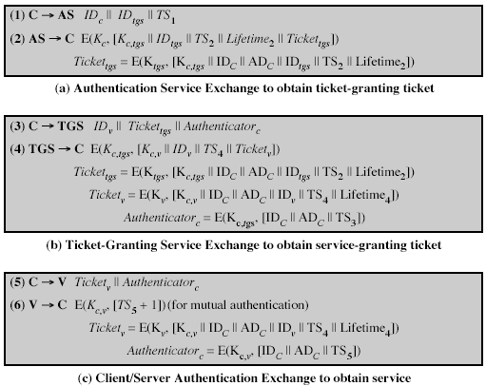
I think Lifetime₄ should also be here (in addition to Ticket_{v})

Slide 36
Kerberos Version 4
Key issues
  authenticator has a very small lifetime (5 ms), so that its replay is not so possible (or at least very hard)
  authenticators are generated by session keys and session keys are known by the client, the server, AS and TGS
    that provides authentication
Session keys can be used to encrypt future communications
Question
  why do we have ID and address fields in authenticators?
Notes:
Kaufman, Perlman, Speciner, pp 326

Slide 37
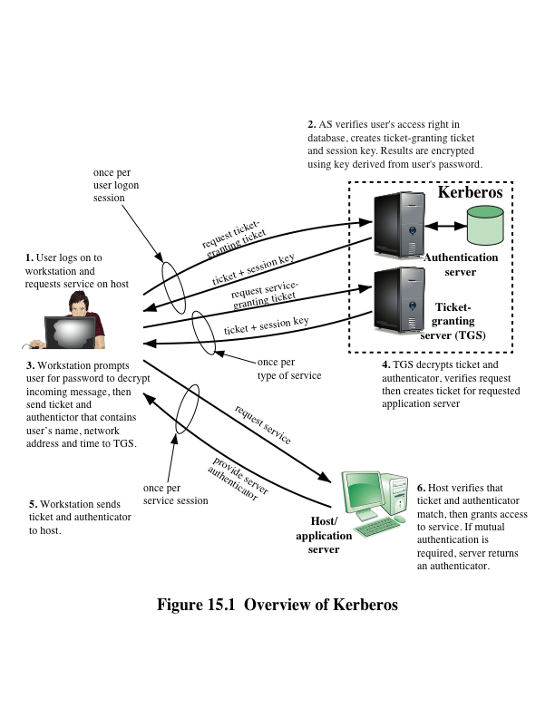
Kerberos 4 Overview

Slide 38
Kerberos 4 Overview
a TTP based authentication scheme that uses symmetric crypto
has an Authentication Server (AS)
  users initially negotiate with AS to identify themselves
  AS provides an authentication credential (ticket granting ticket - TGT)
has a Ticket Granting Server (TGS)
  users subsequently request access to other services from TGS using TGT and authenticator
AS and TGSs are trusted by all clients and servers

Slide 39
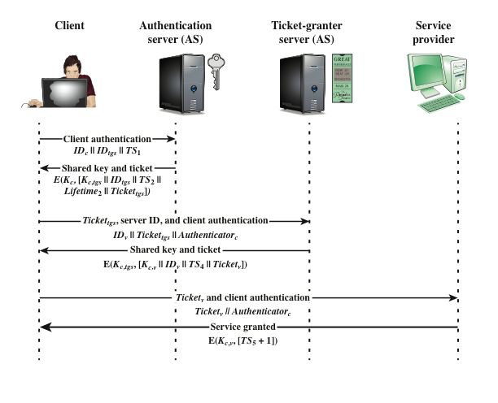
Kerberos 4 Overview

Slide 40
Kerberos Realms
a Kerberos environment consists of:
  a Kerberos server (AS + TGS)
  a number of clients, all registered with Kerberos server
  application servers, sharing keys with Kerberos server
this is termed a realm
  typically a single administrative domain
if there are multiple realms, their Kerberos servers must share keys and trust each other
  N realms means N.(N-1)/2 secure interrealm keys

Slide 41
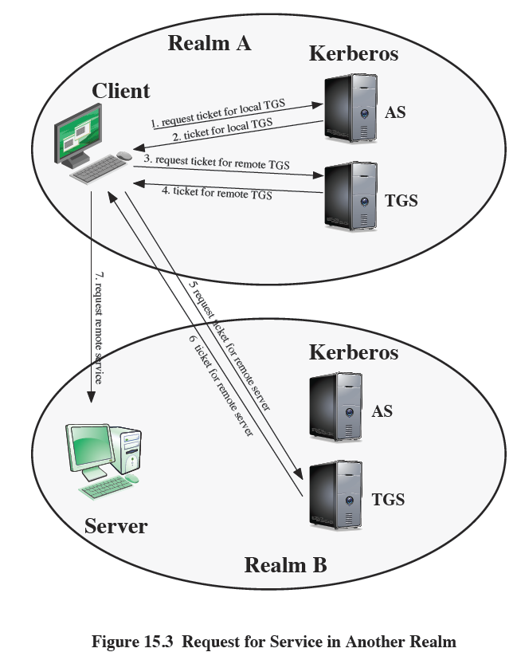
Inter-realm authentication

Slide 42
Kerberos Version 5
developed in mid 1990’s
specified by IETF as RFC 4120
provides improvements over v4
  efforts to make Kerberos general-purpose
    encryption algorithm: v4 was only DES, v5 provides flexibility
    network protocol addresses: v4 was only IP addresses, v5 provides flexibility
    ticket lifetime: v4 was max. 1280 minutes due to length of the lifetime field, v5 supports arbitrary lifetime
    authentication forwarding: In practice a server may access another server on behalf of a client during a transaction. v4 does not, but v5 allows this.

Slide 43
Kerberos Version 5
Kerberos v5 solves some technical deficiencies
  double encryption
    in v4, tickets were unnecessarily doubly encrypted. In v5, this is removed.
  v4 was using a non-standard DES mode which is shown to be vulnerable. v5 uses standard CBC mode
  replays
    are not 100% avoided in v4.
    AS → Client and TGS → Client messages could be replayed during a lifetime of a ticket. In v5 nonces are used
    since sessions keys are the same for multiple client-server connections using the same ticket, encrypted packets from old connections may have been replayed.
    v5 uses subkey mechanisms to avoid this type of replays.

Slide 44
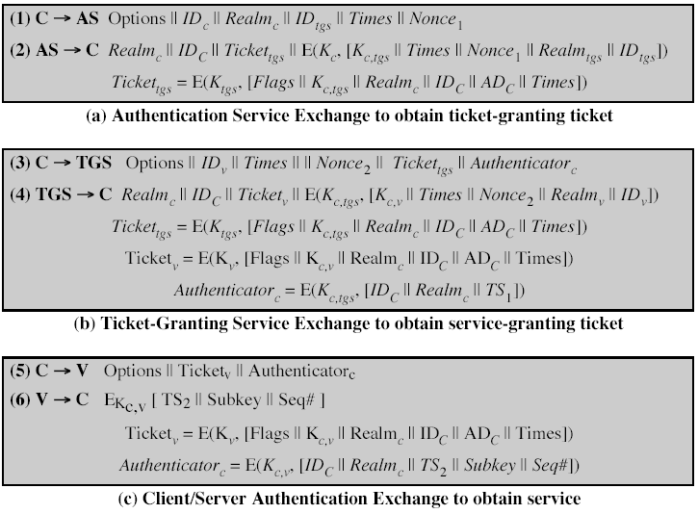
|| Realm_{v}
Notes:
Normally in message 1 client and TGS are in the same realm, so one realm in msg 1 is OK. (ref. Kaufman pp.358)

Slide 45
Differences in messages btw v4 & v5
General
  client realm together with ID_client
  server realm together with ID_server
Message 1
  options (client’s request of ticket functionality (flags)), times (client’s request of ticket validity), nonce (for replay control)
Message 2
  ticket is encrypted only once
  ticket includes flags (current ticket status and other functionality)
  nonce is returned to prove freshness
  Client ID and Realm are added to inform the client about the key to be used to decrypt the message

Slide 46
Differences in messages btw v4 and v5
Message 3
  requested times and options are sent to TGS by Client
  authenticator is essentially same as v4
  nonce
Message 4
  ticket for server has a similar structure as the ticket for TGS
  nonce is returned for replay check

Slide 47
Differences in messages btw v4 and v5
Message 5
  authenticator for server is quite different in v5
    subkey: client’s choice for an encryption key for the session. To avoid replays from previous sessions
    sequence number: optional accompanying mechanism for replays. Indicates the starting value for client-to-server messages
Message 6
  server may enforce its own subkey
  (optional) initial sequence number for server-to-client messages

Slide 48
Some Ticket Flags (Options) – Full list is at pp. 498-500 of Stallings
Renewable
  long lived tickets are risky (may be stolen and the opponent can use until the expiration time)
  short lived ones cause protocol overheads
    for TGT, the user should enter password for each ticket
  Solution: ticket originally has short lifetime, but can be periodically (and automatically) renewed
    until renew-till time specified in the ticket
    unless TGS or AS refuses to renew it (if stolen)

Slide 49
Ticket Flags (some of them)
Proxiable / Proxy
  If a TGT is proxiable, then TGS may issue proxy tickets that the ticket owner (say Alice) may give some other servers that may act on behalf of Alice
Forwardable / Forwarded
  more powerful than proxy
    proxy flag can be set only in server tickets
    forwarded flag can be set also in TGTs
  if a TGT bears a forwardable flag set, than TGS may issue forwarded TGTs for a nearby realm
    nearby realm’s TGS may either forward or issue a server ticket.
    In this way, realms can be connected

